Slide 1

HTML-CSS
January 10th, 2018

Slide 2


Who we are
Aristeidis Bampakos (Aris)
Front End Web Developer @ Plexscape
George Sisko (Jkr)
.NET Web Developer @ Relational SA
Twitter: @abampakos
Github: https://github.com/bampakoa
Twitter: @GeorgeJkrr
Github: https://github.com/jkrgS

Slide 3
Agenda
Responsive web development
Units of measurement
Positioning elements
Floating / Clearing elements
Flexbox design
Developer tools / Inspector

Slide 4
Responsive web development
“Responsive web design (RWD) is an approach to web design which makes web pages render well on a variety of devices and window or screen sizes. Recent work also considers the viewer proximity as part of the viewing context as an extension for RWD. Content, design and performance are necessary across all devices to ensure usability and satisfaction.”

Slide 5
RWD explained
A practice of building a website suitable to work on every device and every screen size, no matter how large or small, mobile or desktop
Dynamically adapt to different browser and device viewports, changing layout and content along the way
Viewers of public displays perceive the content of a display at different sizes according to their distance from the display
Notes:
While responsive design adapts web content to different viewing contexts, so far only the characteristics of the device and browser are taken into account. These techniques could be extended to consider viewer proximity as part of the viewing context in the case of public displays

Slide 6
Why should you use it
No need to maintain separate websites for desktops and mobile phones
Collect all social sharing links through a single URL address (SEO friendly)
Provide the same user experience across all devices and screens

Slide 7
Demo time!
http://www.socialhackersacademy.org/

Slide 8
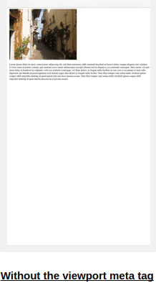
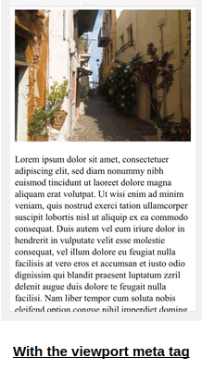
Viewport
It is the area of a web page that is visible from the user. Varies according to the device.
<meta name="viewport" content="width=device-width, initial-scale=1.0">
Notes:
A <meta> viewport element gives the browser instructions on how to control the page's dimensions and scaling.
The width=device-width part sets the width of the page to follow the screen-width of the device (which will vary depending on the device).
The initial-scale=1.0 part sets the initial zoom level when the page is first loaded by the browser.

Slide 9
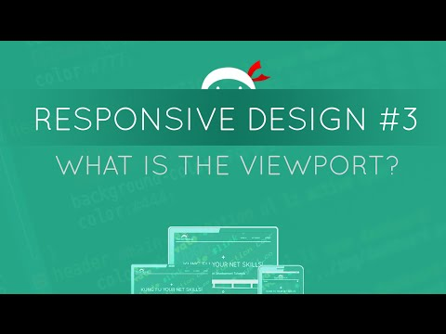
Demo time!

Slide 10
Responsive elements
Set width and max-width for images
If the width property is set to 100%, the image will be responsive and scale up and down
<img src="myimage.jpg" style="width:100%;">
If the max-width property is set to 100%, the image will scale down if it has to, but never scale up to be larger than its original size
<img src="myimage.jpg" style="max-width:100%;height:auto;">

Slide 11
Responsive elements
Set viewport width (vw) for text
The text size will follow the size of the browser window
<h1 style="font-size:10vw">Hello World</h1>

Slide 12
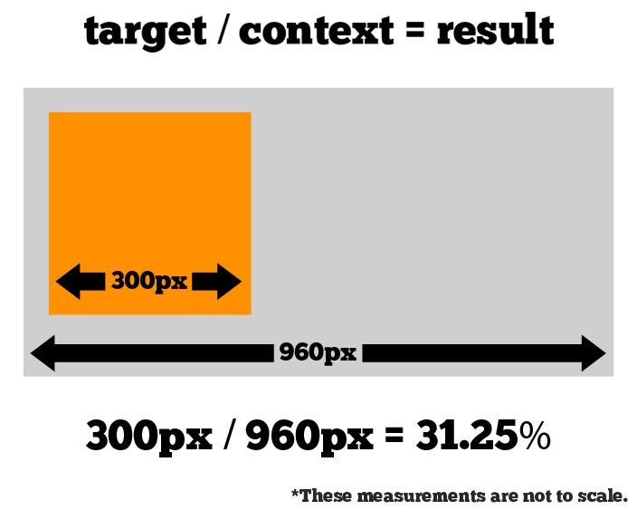
Fluid layout
Use percentage % rather than fixed measurement units such as pixels or inches
A fluid grid is more carefully designed in terms of proportions
All of the elements in the layout will resize their widths in relation to one another.
Applicable to media such as images, videos and fonts.

Slide 13
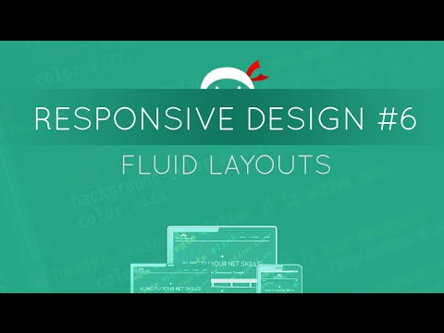
Demo time!

Slide 14
Media queries
“Media Queries is a CSS3 module allowing content rendering to adapt to conditions such as screen resolution (e.g. smartphone screen vs. computer screen). It became a W3C recommended standard in June 2012, and is a cornerstone technology of responsive web design (RWD)”

Slide 15
Media queries explained
Apply different CSS styles depending on the type of a device (such as a screen or content in print preview) or its specific characteristic (such as the width of the viewport)
A useful tool due to the huge variety of connected devices
Use @media rule to include a block of CSS properties when a certain condition is true

Slide 16
Media types
Media types define the type of a device:
all: targets all devices
print: used for content viewed on a screen in print preview mode
screen: intended for color computer screens
speech: targets speech synthesizers
The types that are most commonly used are all and screen.
Usage: @media type { ... }

Slide 17
Media features
Media features describe the specific characteristic of a browser, device or environment
There is an extensive list of available characteristics here
Range features are commonly used that are prefixed with “min-” or “max-” to define minimum or maximum constraints such as min-width or max-height.
If a feature does not apply to a device, the styles of that feature will be ignored and never be applied
Usage: @media (feature) { ... }

Slide 18
Breakpoints
The point at which the content of your site will respond to provide the user with the best possible layout to consume the information
Introduce them gradually
Design for the smallest viewport first
Expand the view at the point at which the design seems broken
Add a media rule
Common device breakpoints
Always design for mobile first

Slide 19
Complex media queries
Need to create a media query that depends on multiple conditions
Use logical operators:
not: inverts the meaning of a media query
and: combines a media feature with media type or other features
only: used in older browsers to avoid applying the rule
Combine multiple media queries into a comma-separated list

Slide 20
Complex media queries
@media (min-width: 120px) and (orientation: landscape) { ... }
@media not screen { ... }
<link rel="stylesheet" media="only screen" href="modern-styles.css" />
@media (min-height: 680px), screen and (orientation: portrait) { ... }

Slide 21
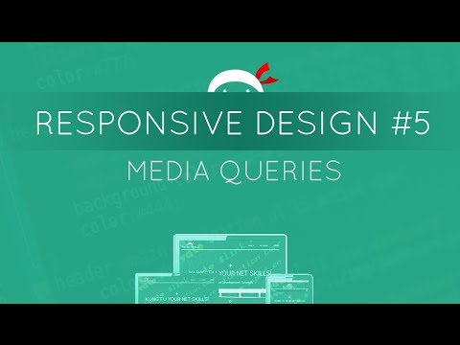
Demo time!

Slide 22
Disadvantages
Slow loading times due to unnecessary HTML/CSS files that need to be downloaded
Extra time to create a responsive web site. Even more to convert an existing one
Not compatible with old versions of IE
Notes:
Better to design a responsive site from the start. Incompatibility with old version of IE is not a big deal

Slide 23
Measurement units
Define the length of an element through properties such as width, margin and padding
Combined with numbers to form the length of an element, e.g. 15px, 2em
When the length is 0, the unit can be omitted
Negative lengths are allowed in some cases
There are two types of units: absolute and relative

Slide 24
Absolute lengths
They are fixed
Elements appear exactly the size of the length
Not recommended for use on screen
They can be used when the output medium is known such as in a print layout
Include physical units such as cm, mm, in and px.

Slide 25
Relative lengths
Specify a length relative to another length property
Scales better with both screen and print media types
Most frequently used unit
The most commonly used relative lengths are:
%: percentage, relative to the same property of the parent element
em: relative to font size of the element
rem: relative to font size of the root element
vw: relative to 1% of viewport width

Slide 26
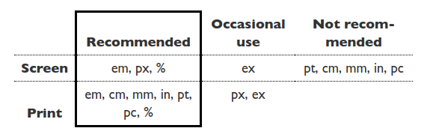
Recommended units per media type
https://www.w3.org/Style/Examples/007/units.en.html

Slide 27
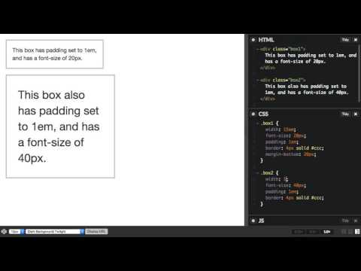
Demo time!

Slide 28
Positioning
“Positioning allows you to take elements out of the normal document layout flow, and make them behave differently, for example sitting on top of one another, or always remaining in the same place inside the browser viewport. This section will been explain the different position values, and how to use them.”

Slide 29
Positioning explained
Positioning allow us to override the basic document flow behaviour, to produce interesting effects.
There are a number of different types of positioning that you can put into effect on HTML elements. To make a specific type of positioning active on an element, we use the “position” property.
Absolute
Relative(Top, Bottom, Left, Right)
Fixed

Slide 30
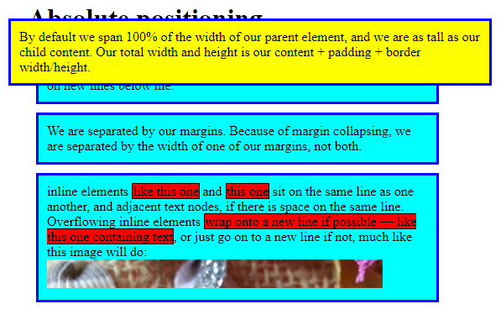
Position: Absolute
We can create isolated UI features that don't interfere with the position of other elements on the page — for example popup information boxes and control menus, rollover panels, UI features that can be dragged and dropped anywhere on the page.

Slide 31
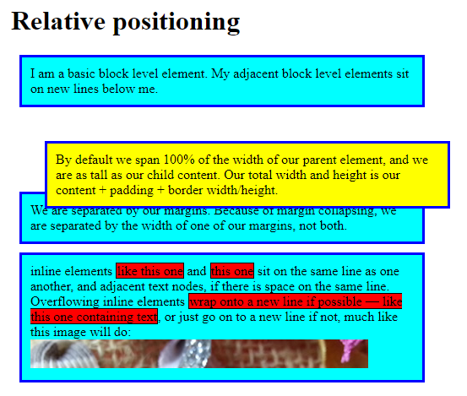
Position: Relative
With Relative positioning you have to modify its final position , including making overlap other elements on the page. That elements are top, bottom, left and right.

Slide 32
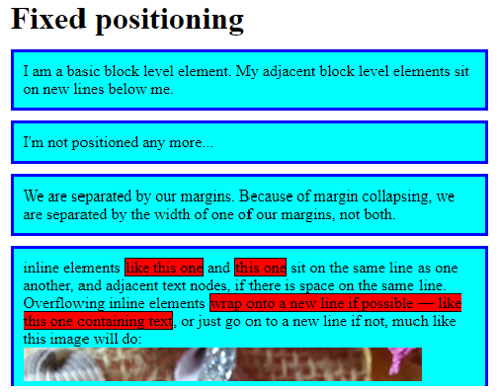
Position: Fixed
This works in exactly the same way as Absolute positioning, with one key difference — whereas absolute positioning fixes an element in place relative to the <html> element or its nearest positioned ancestor, fixed positioning fixes an element in place relative to the browser viewport itself.
Absolute
Fixed

Slide 33
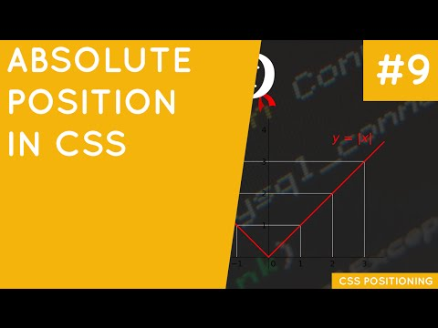
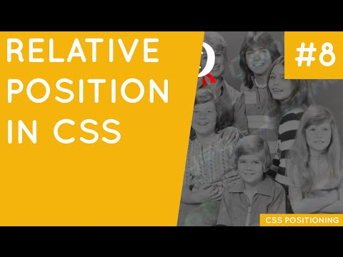
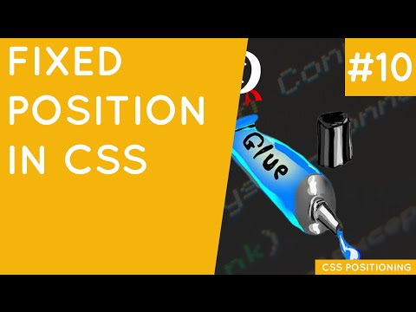
Demo time!

Slide 34
Floating & Clearing
“The float property was introduced to allow you to implement simple layouts involving an image floating inside a column of text, with the text wrapping around the left or right of it. The kind of thing you might get in a newspaper layout.”
“The clear property. When you apply this to an element, it basically says "stop floating here" — this element and those after it in the source will not float, unless you apply a new float declaration to another element later on.”

Slide 35
Floating
Involve an image floating inside a column of text
Floats also are used very commonly these days to create entire web site layouts featuring multiple columns of information floated so they sit alongside one another (the default behaviour would be for the columns to sit below one another, in the same order as they appear in the source).

Slide 36
Clearing
Float's sister property is clear. An element that has the clear property set on it will not move up adjacent to the float like the float desires, but will move itself down past the float.
Clear has four valid values as well. Both is most commonly used, which clears floats coming from either direction. Left and Right can be used to only clear the float from one direction respectively.

Slide 37
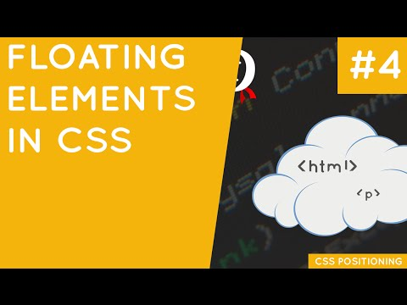
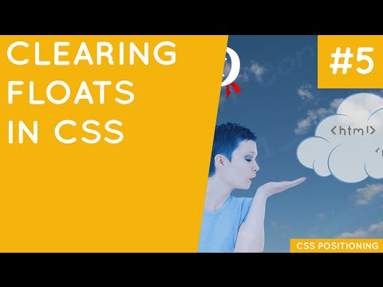
Demo time!

Slide 38
Flexbox
“A new technology, but with support now fairly widespread across browsers, Flexbox is starting to become ready for widespread use. Flexbox provides tools to allow rapid creation of complex, flexible layouts, and features that historically proved difficult with CSS.”

Slide 39
Flexbox explained
Vertically centering a block of content inside its parent.
Making all the children of a container take up an equal amount of the available width/height, regardless of how much width/height is available.
Making all columns in a multiple column layout adopt the same height even if they contain a different amount of content.

Slide 40
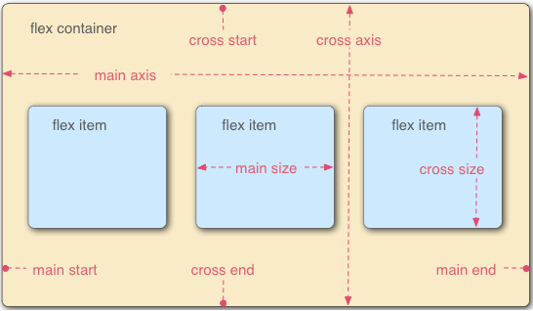
Flex Model
The main axis is the axis running in the direction the flex items are being laid out in (e.g. as rows across the page, or columns down the page.) The start and end of this axis are called the main start and main end.
The cross axis is the axis running perpendicular to the direction the flex items are being laid out in. The start and end of this axis are called the cross start and cross end.
The parent element that has display: flex set on it, is called the flex container.
The items being laid out as flexible boxes inside the flex container are called flex items .

Slide 41
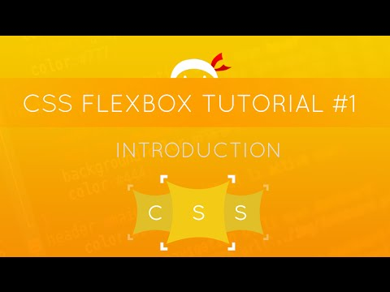
Demo time!

Slide 42
DOM/Style Inspector
A tool to inspect the DOM, its elements and their styles
To use it:
Open Google Chrome
Select the Chrome Menu -> Tools -> Developer Tools
Right click on any element of the page and select Inspect Element. Alternatively, you can use the Select element tool which is located on the top left corner
Useful for debugging and modifying HTML attributes and CSS rules runtime

Slide 43
Elements tab
Contains the actual DOM of the webpage
Provides context menu for manipulating elements such as:
Add/Edit HTML attributes
Edit whole HTML blocks
Hide/Delete elements
Styles tab: Live-edit style property names and values
Computed tab: Edit the current element's box model parameters
Event listeners tab: provide hooks to the element’s DOM events
Properties tab: displays the properties of the DOM element

Slide 44
Demo time!
http://www.socialhackersacademy.org/

Slide 45
Game is ON!
Go to https://kahoot.it/
Enter the Game PIN that you see on the screen
Pick up a nickname
Get ready!

Slide 46

Questions?

Slide 47
Thank you!
Aristeidis Bampakos @abampakos
George Sisko @GeorgeJkrr

